Slide 1
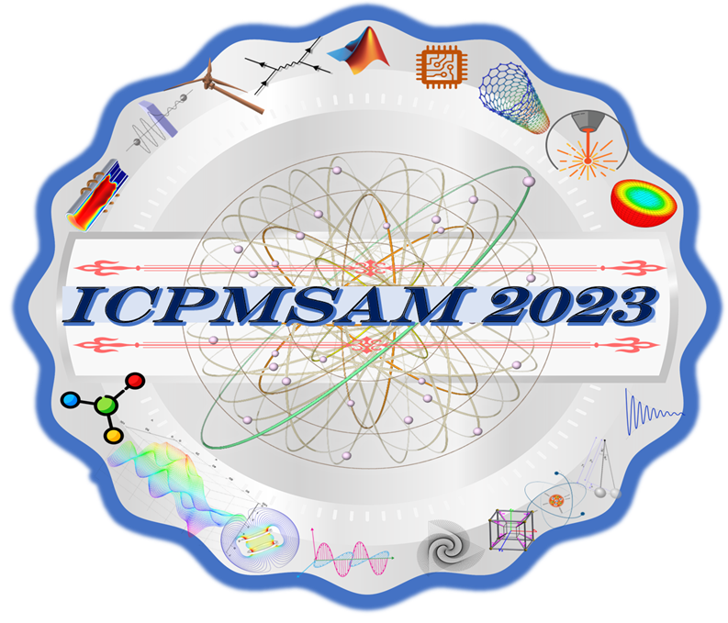
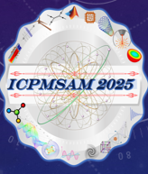
2 ^{nd} international conference on physico-chemistry, materials sciences & applied mathematics
ICPMSAM’25
October 15-16, 2025, Skikda, Algeria
Your institution
Manuscript ID-XX
Title (Times New Roman – police 54 – in bold)
Autors (Times New Roman – police 44 )
Organisation (Times New Roman – police 32 )
ABSTRACT
RESULTS AND DISCUSSIONS
Results Presentation
Texte : Times New Roman – police 24
INTRODUCTION
Texte : Times New Roman – police 24
Texte : Times New Roman – police 24
METHODS & MODELISATION
System Presentation
Texte : Times New Roman – police 24
Discussions of Results
Model Development / Experimental Procedure
Texte : Times New Roman – police 24
Texte : Times New Roman – police 24
CONCLUSIONS
Texte : Times New Roman – police 24

